Slide 1
Template matching using Normalised Cross Correlation
Presented By
Name: Susmoy Sen Gupta
ID: 1603110201234(A)
Batch: 31st
Notes:
Template matching By using normalised cross correlation

Slide 2
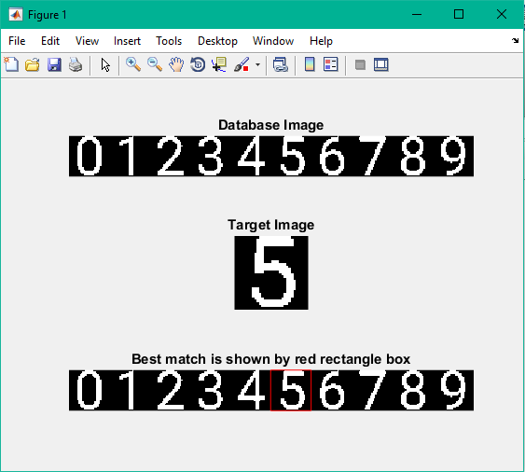
G
O
A
L
Number Recognition from a given number image
Page 01

Slide 3
Motivation
Its straightforward implementation has expanded its usage for real-time applications and problems.
Page 02

Slide 4
Application
Page 03

Slide 5
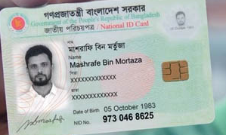
National ID Card
Application
Page 04

Slide 6
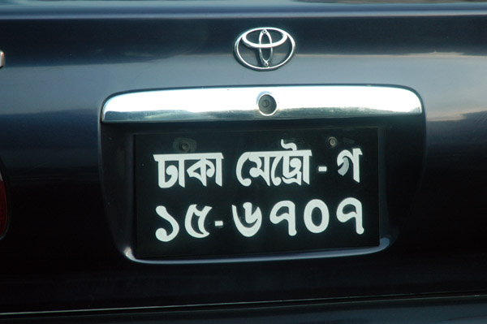
2. Vehicle Number Plate
Application
Page 05

Slide 7
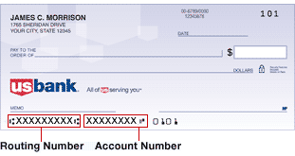
3. Bank Identification
Application
Page 06

Slide 8
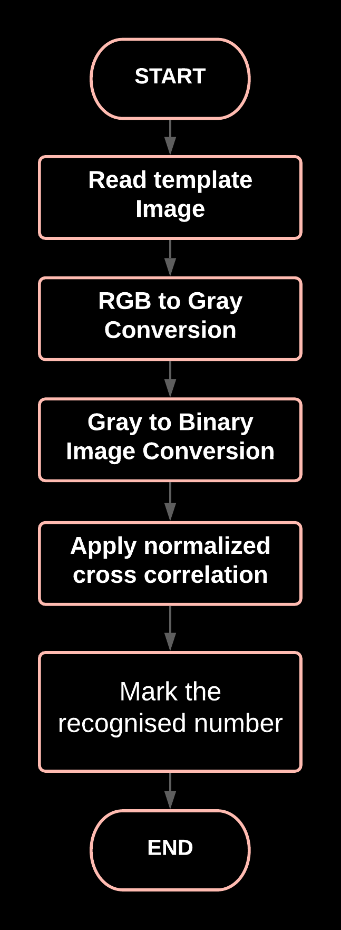
Framework
Page 07

Slide 9
Processing example
Page 08

Slide 10





Processing Example
Page 09

Slide 11
Conclusion
Page 10

Slide 12
Merit
Conclusion
Easy implementation.
Simple, efficient
Fast working
Page 11

Slide 13
Demerit
Conclusion
Not effective for large template
Very sensitive to any rotations or scale change
Page 12

Slide 14
Thank you...
Page 13

